Slide 1

Module 3
Advanced Multiple Linear Regression (MLR)
Notes:
Guidelines
Use section headers to chunk content in your presentation.
Use the same style of section header throughout your presentation.
Keep your title to no more than 2 lines.

Slide 2
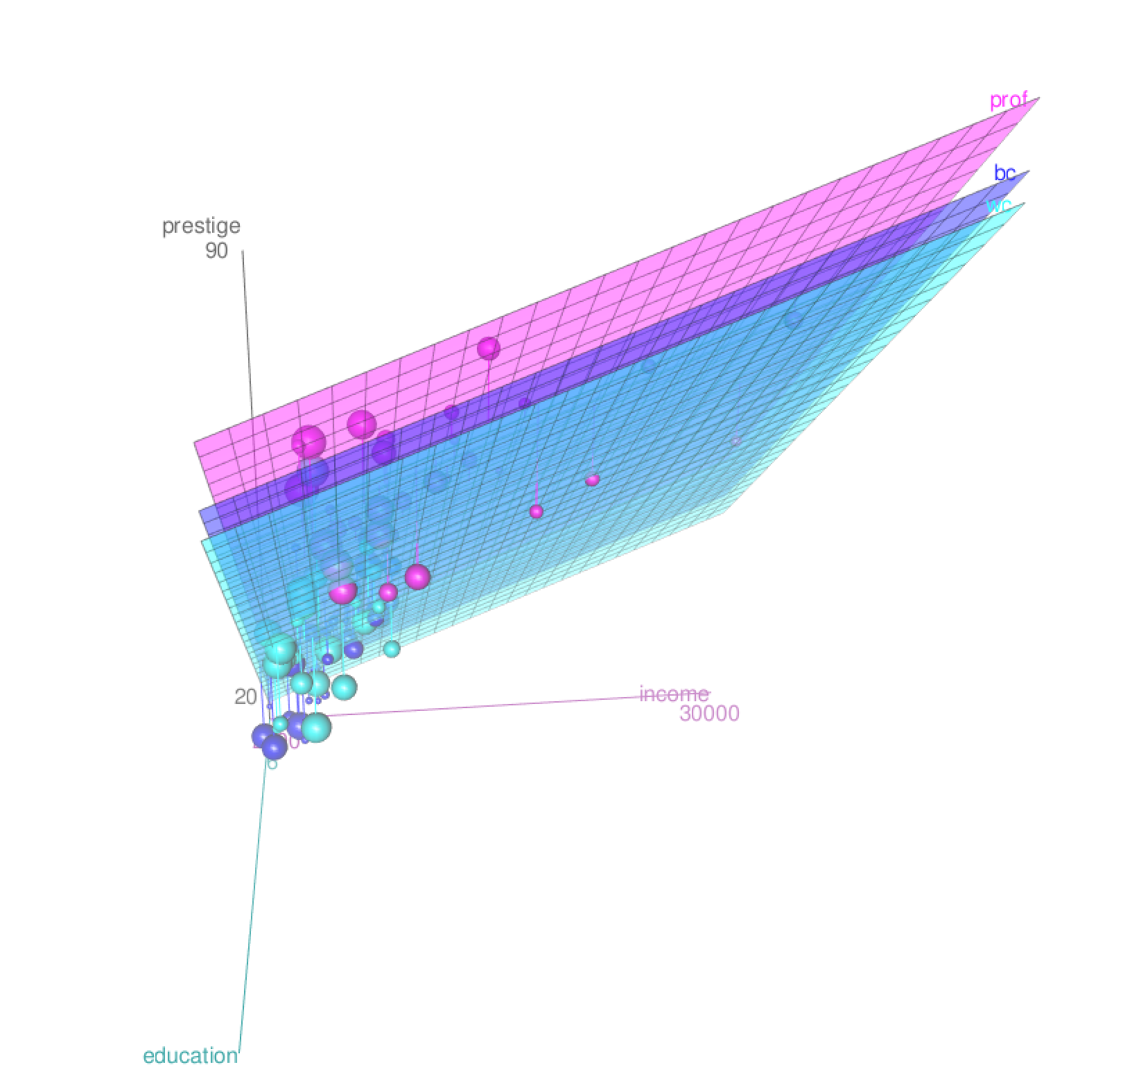
Model Complexity, DF
Notes:
Guidelines
Use a title slide at the beginning of your presentation. There are 9 variations of title slides to choose from.
If you will have a series of slideshows, we recommend using the same style of title slide for each presentation.
Keep your title to no more than 2 lines.
Do not change the font style or font size of the title or subtitle.

Slide 3
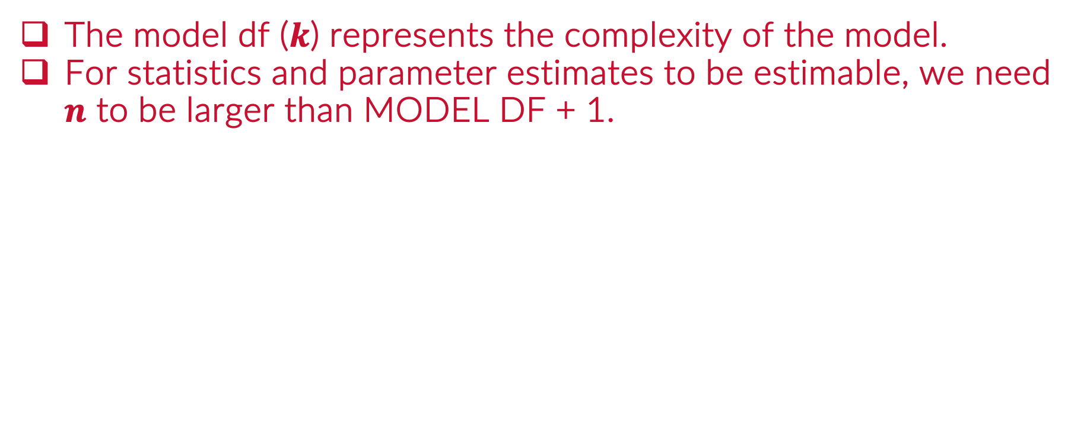
Model Complexity
The model df ($k$) represents the complexity of the model.
For statistics and parameter estimates to be estimable, we need $n$ to be larger than MODEL DF + 1.

Slide 4
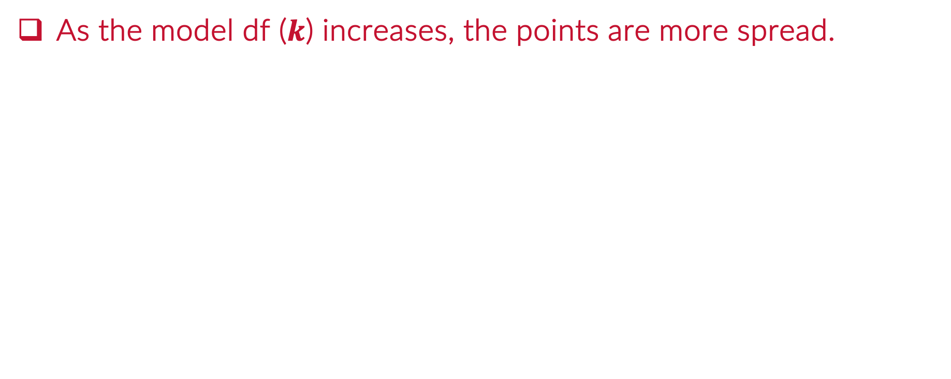
The Curse of Dimensionality
As the model df ($k$) increases, the points are more spread.

Slide 5
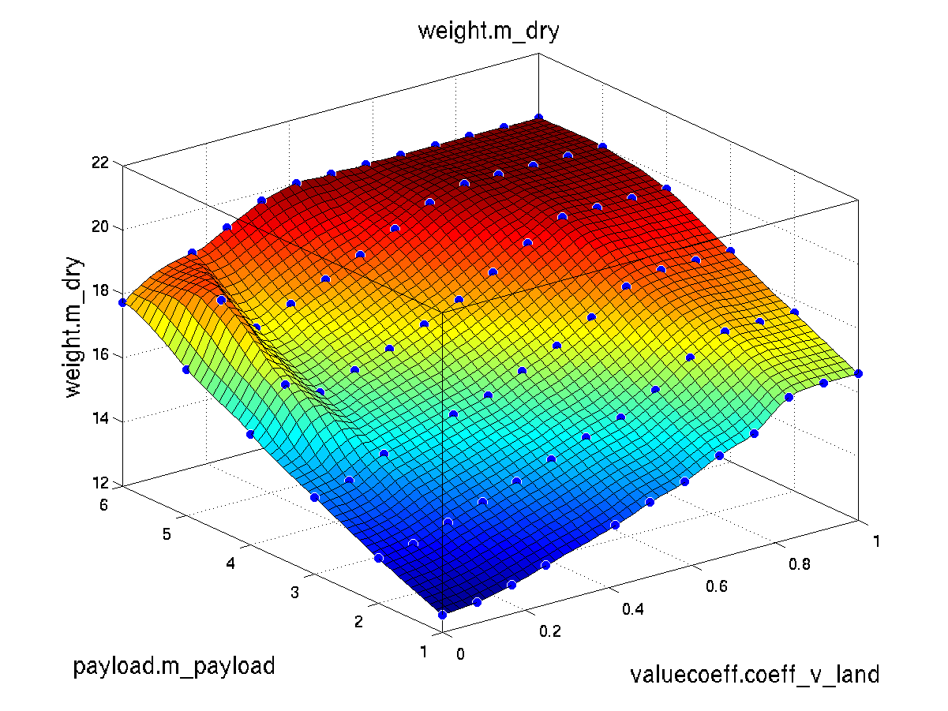
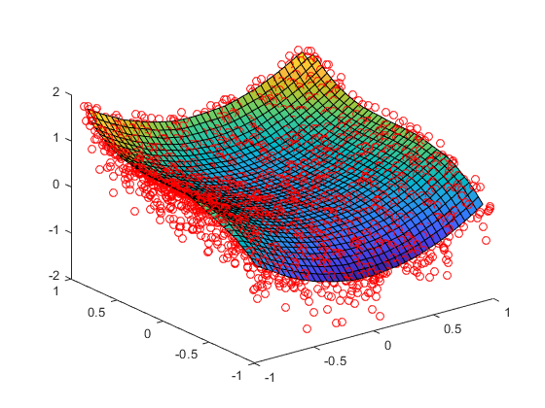

The Curse of Dimensionality
As the model df ($k$) increases, the points are more spread.

Slide 6
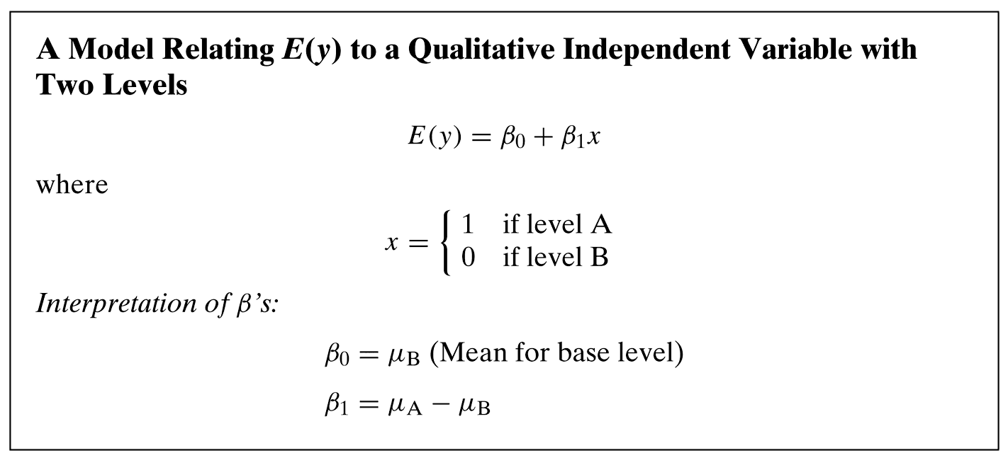
Dummy-Encoding

Slide 7
Dummy-Encoding

Slide 8
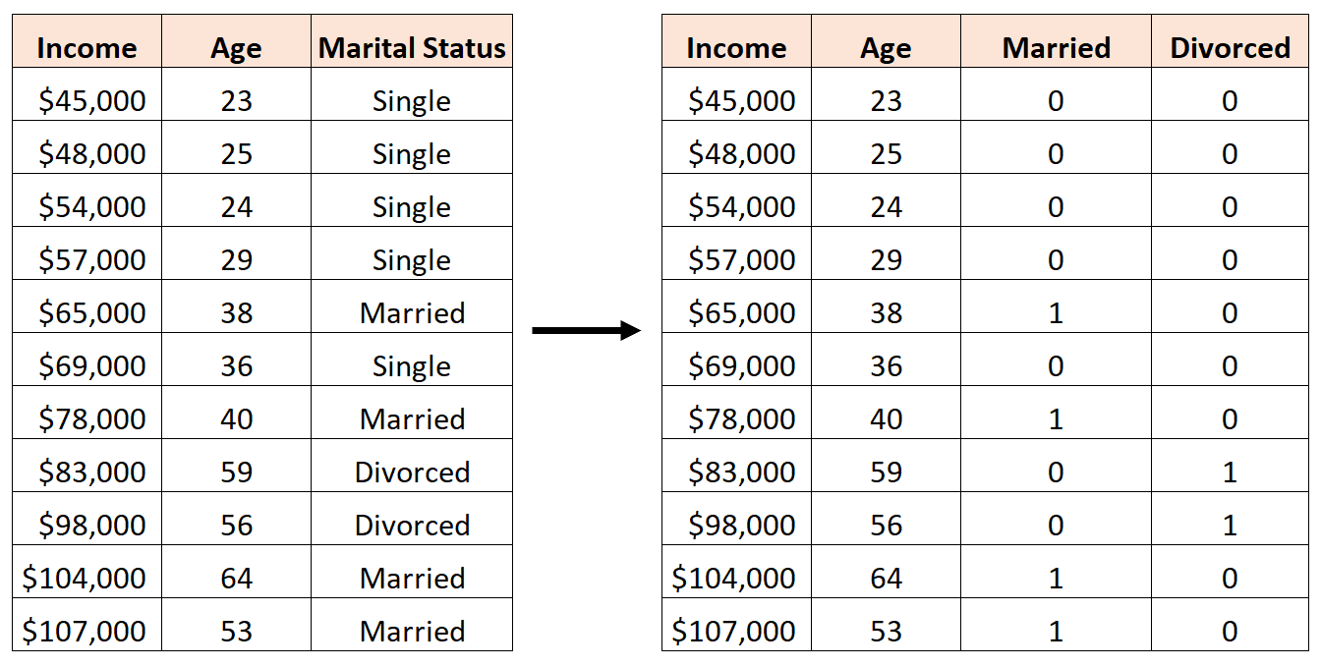
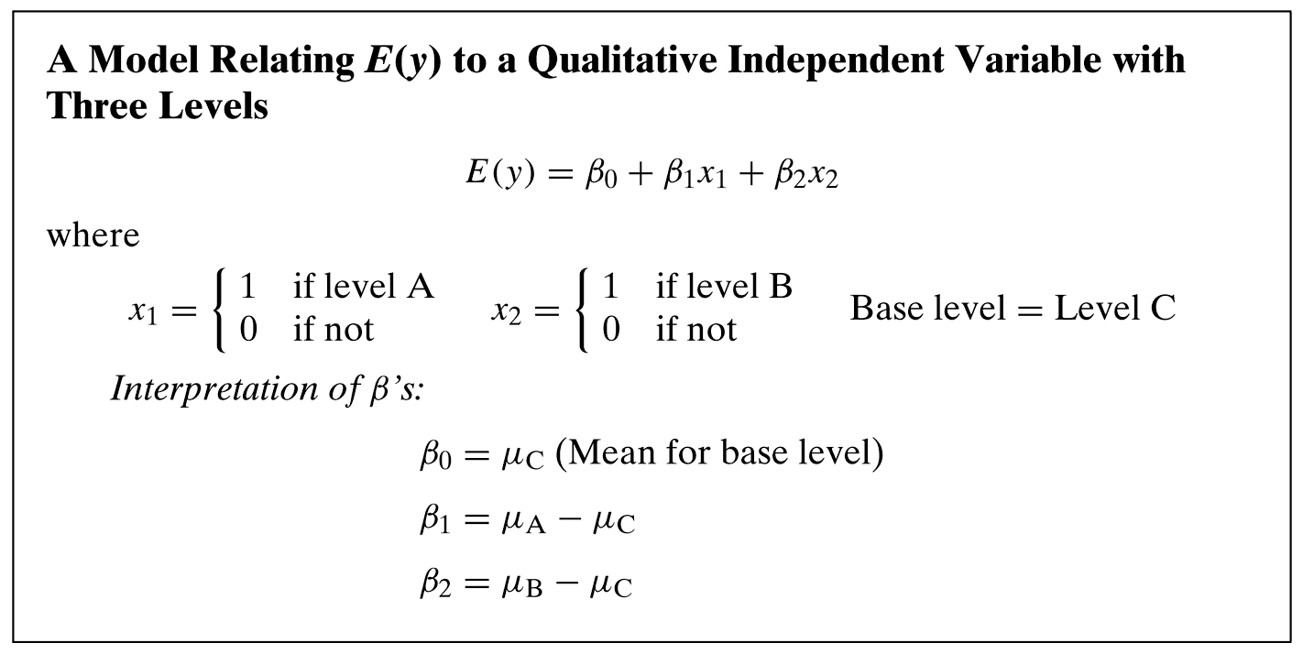
Dummy-Encoding

Slide 9
Model DF
Quantitative (Numeric) Predictors: contribute 1 model df
Categorical Predictors: contribute (# levels – 1) model df

Slide 10
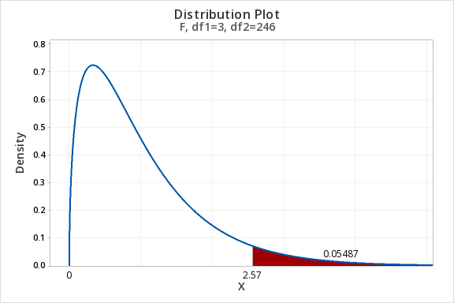
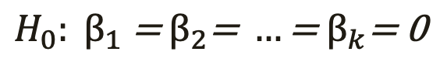
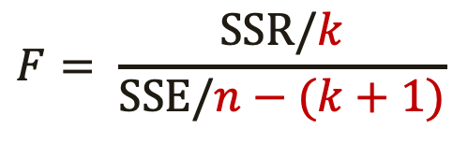
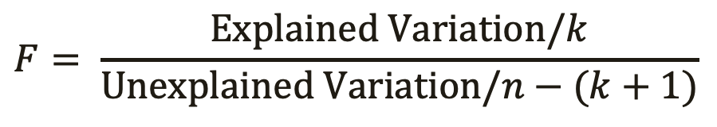
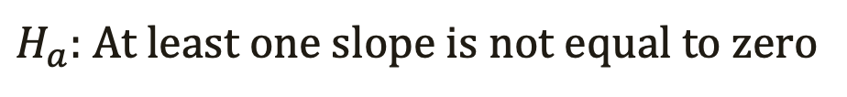
Overall Test of Significance
Hypothesis Test
Test Statistic
$$H_{0}: β_{1}\text{ = }β_{2}\text{= }…\text{= }β_{k}\text{= 0}$$
$H_{a}:$ At least one slope is not equal to zero
$$F= \frac{Explained Variation/k}{Unexplained Variation/n−(k+1)}$$
$$F= \frac{SSR/k}{SSE/n−(k+1)}$$
Numerator df (MODEL DF)
Denominator df (ERROR DF)

Slide 11

Practice

Slide 12
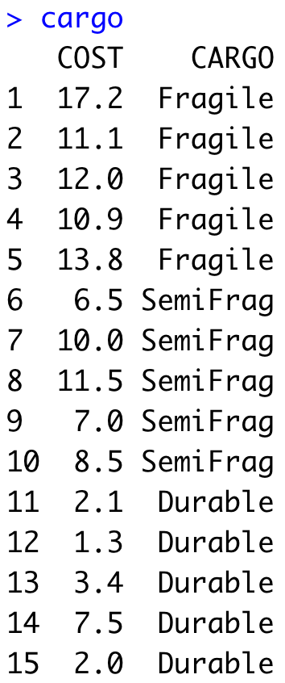

Example: CARGO Cost
Predict Cost of Cargo using CARGO type

Slide 13


How many degrees of freedom does the variable CARGO have?
ⓘ Start presenting to display the poll results on this slide.

Slide 14
Using R, what would be the reference level for the variable CARGO?
ⓘ Start presenting to display the poll results on this slide.

Slide 15
What are the total model degrees of freedom (k) if we use the variable CARGO as a predictor ?
ⓘ Start presenting to display the poll results on this slide.

Slide 16
Practice

Slide 17
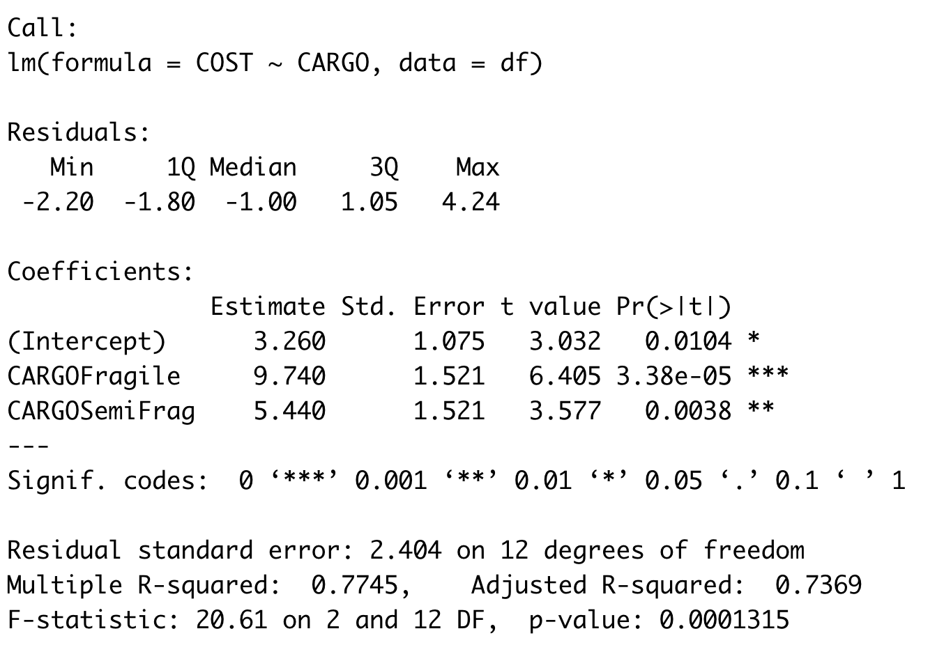
Example: CARGO Cost
Parameter Estimates

Slide 18
What is the estimated COST of "durable" packages?
ⓘ Start presenting to display the poll results on this slide.

Slide 19
What is the estimated COST of fragile packages?
ⓘ Start presenting to display the poll results on this slide.

Slide 20
Practice

Slide 21
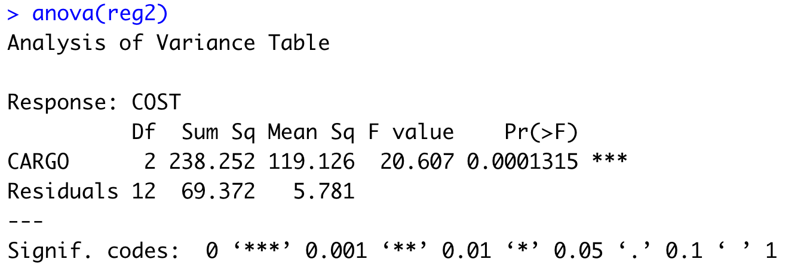
Example: CARGO Cost
ANOVA

Slide 22
Practice

Slide 23
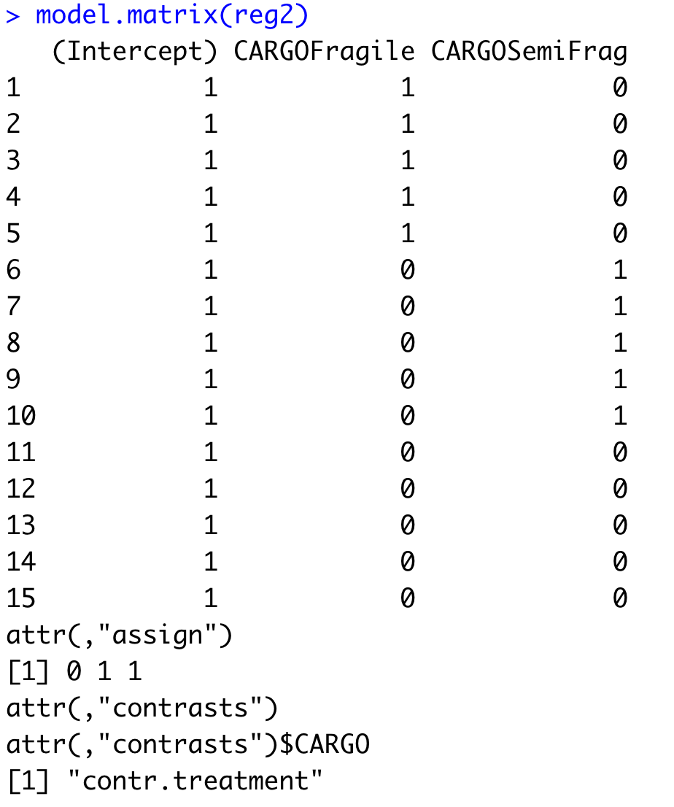
Example: CARGO Cost

Slide 24
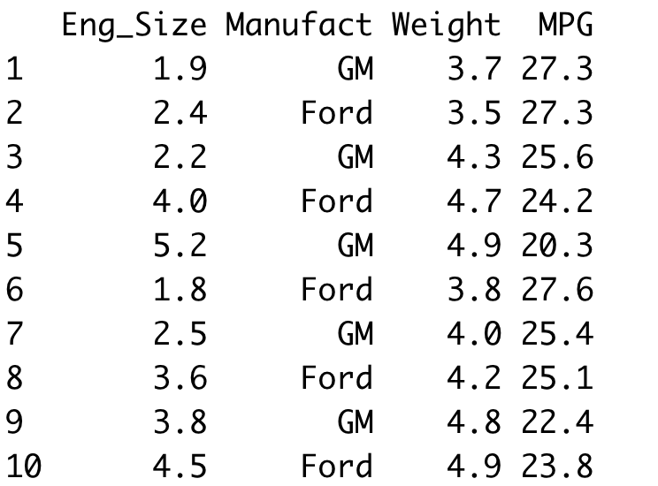
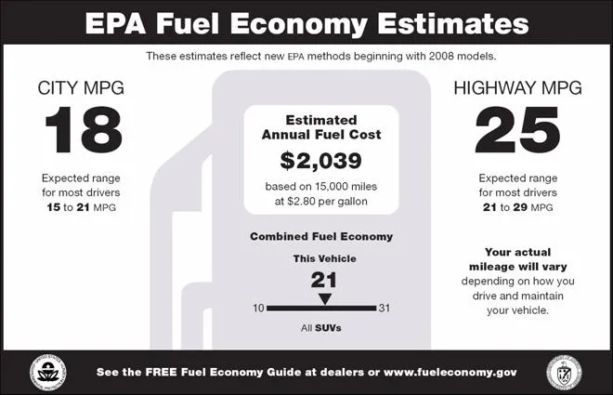
Example: MPG Prediction
Predict Combined MPG based on Manufacturer, Engine Size and Weight

Slide 25
Example: MPG Prediction
Encoding variable Manufact
0 if Manufact = “GM”
ManufactFord =
1 if Manufact = “Ford”
MfD

Slide 26
Example: MPG Prediction
Encoding variable Manufact
β2 is the slope associated with MfD and is the average difference in MPG between Ford and GM.

Slide 27
Example: MPG Prediction
Encoding variable Manufact
0 if Manufact = “Ford”
ManufactGM =
1 if Manufact = “GM”

Slide 28
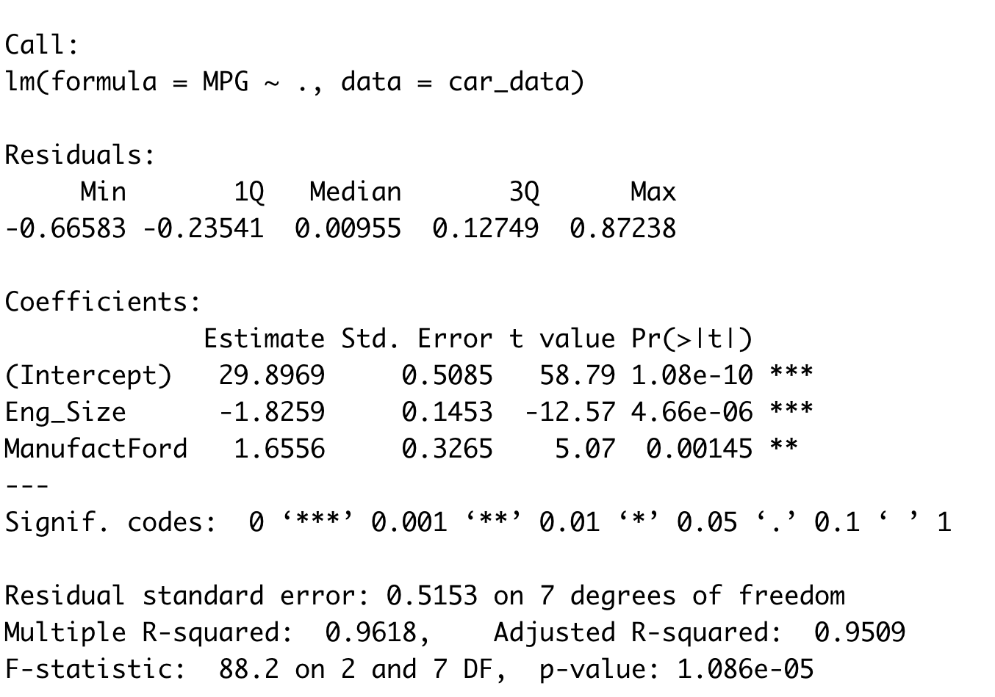
Example: MPG Prediction
Slope of Eng_Size stays the same
Estimates the average difference in MPG between Ford & GM
at any engine size

Slide 29
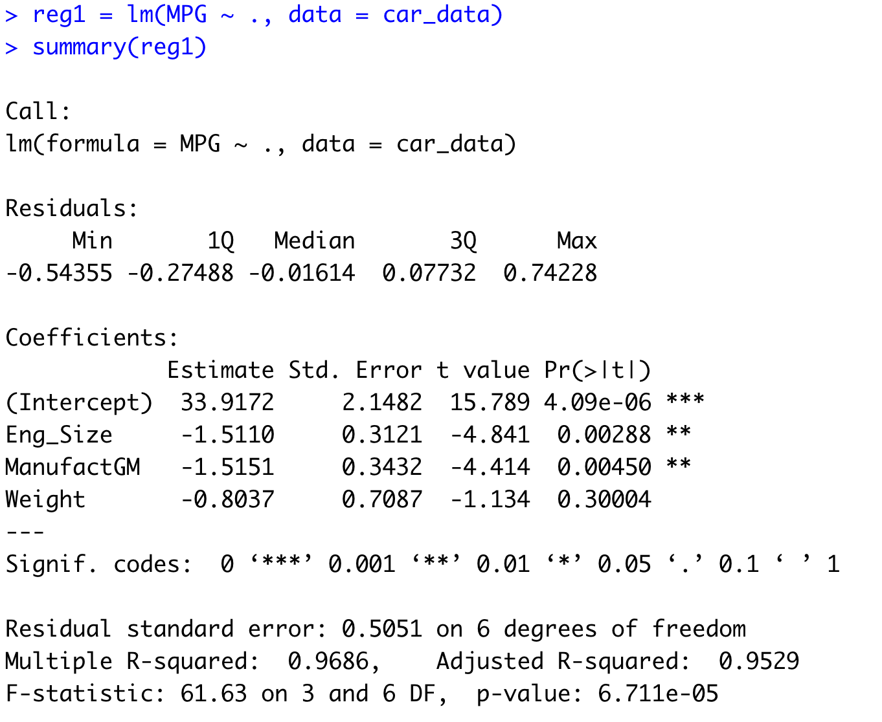
Example: MPG Prediction

Slide 30
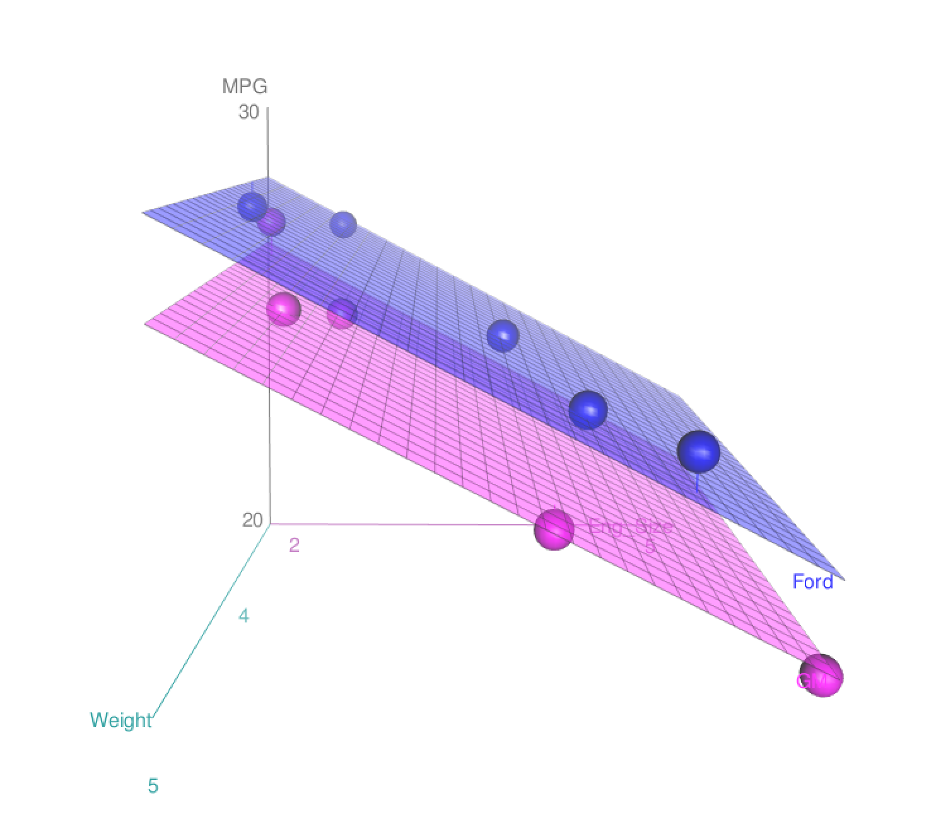
Example: MPG Prediction

